Slide 1
OneDot Data Processing
Last Update: 08/08/2021
Marcos Gomez-España Pecker

Slide 2
Table of Contents
1. Introduction
2. Key Facts of Input/Output
3. Summary of Changes to Input Data
4. Summary of Potential Changes
5. Take Away Message
Marcos Gomez-España Pecker

Slide 3
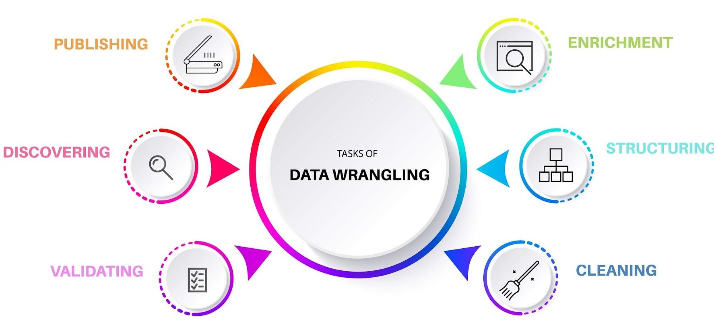
Introduction
1
We are going to talk about how we can easily process data from new suppliers in an efficient and easy way. Furthermore, we will discuss the process itself as well as some enrichments we can offer. Finally, some adcvices would be given for customers
Marcos Gomez-España Pecker

Slide 4
Key facts of Input/Output
2
Number of Attributes: The number of attributes of the incoming data is free, however only a certain number of columns will be used.
Missing Values: If there are missing values in the dataset or after the data wrangling, these will be managed in a way that it doesn’t affect the customer.
1
3
2
Number of Records: The number of record will maintain the same throughout the whole process. The records of the same product will be grouped so a unique way to identify products is needed
4
Final output: The final output will have always the same number of columns (18).
Marcos Gomez-España Pecker

Slide 5
Summary of Changes to Input Data
3
1. Loading Data
3. Translation
5. Integration
2. Pre-Processing
4. Normalization
First, we load the data from the json file into a pandas DataFrame. We process the data using python and pandas.
In this step, data is translated to English. For this step to work we need a json with the translations. If needed, a API call to google could translate the texts needed
We discard not wanted columns and mantain those we need. Finally we export the processed data into a excel file
Load Data
Pre-Processing
Translation
Normalization
Integration
Second, we preprocess the data by unstacking column values into new columns. By this, we achieve the same granularity we need for the output file.
Here we rename the columns, cast them to the correct type and apply any function needed to the data in order to obtain the desired end results
Marcos Gomez-España Pecker

Slide 6


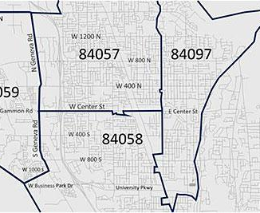
Summary of Potential Changes
4
01 | Translate text using googletrans api
02 | Obtain zip based on city
03 | Use country currency as currency
Marcos Gomez-España Pecker

Slide 7
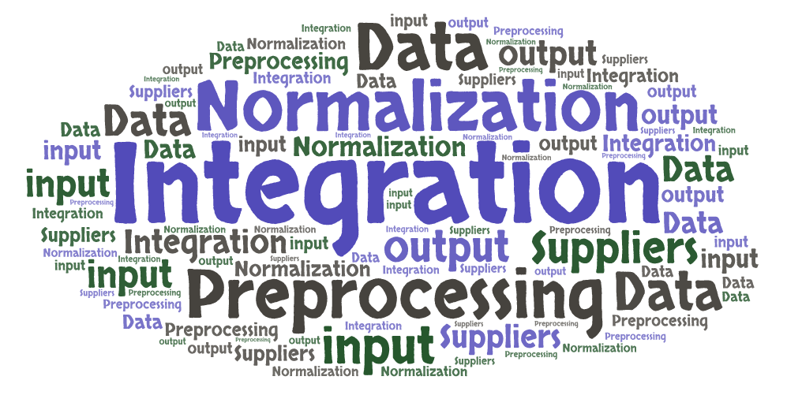
Take Away Message
5
We can effectively process data from other suppliers, however, because we need to meet a certain format, we need some data in particular and data not meeting the final format is lost.
Customer Consequences:
To improve the quality of the output it would be wise to add some information about currency, drive or price on request. Moreover, we can improve the final format to add more information.
Marcos Gomez-España Pecker

Slide 8
Any Questions?
Marcos Gomez-España Pecker

